Slide 1
Hand Signs Detection
Using Deep Learning
Arbaz Sayed
21070243043

Slide 2
01
MediaPipe
02
04
TensorFlow
Prediction
03
OpenCV

Slide 3

MediaPipe
Media Pipe Solutions:
What is MediaPipe?
Media Pipe is a Framework for building machine learning pipelines for processing time-series data like video, audio, etc. This cross-platform Framework works in Desktop/Server, Android, iOS, and embedded devices like Raspberry Pi and Jetson Nano.
Solutions are open-source based on a specific pre-trained TensorFlow or TF Lite model. Media Pipe Solutions are built on top of the Framework.

Slide 4
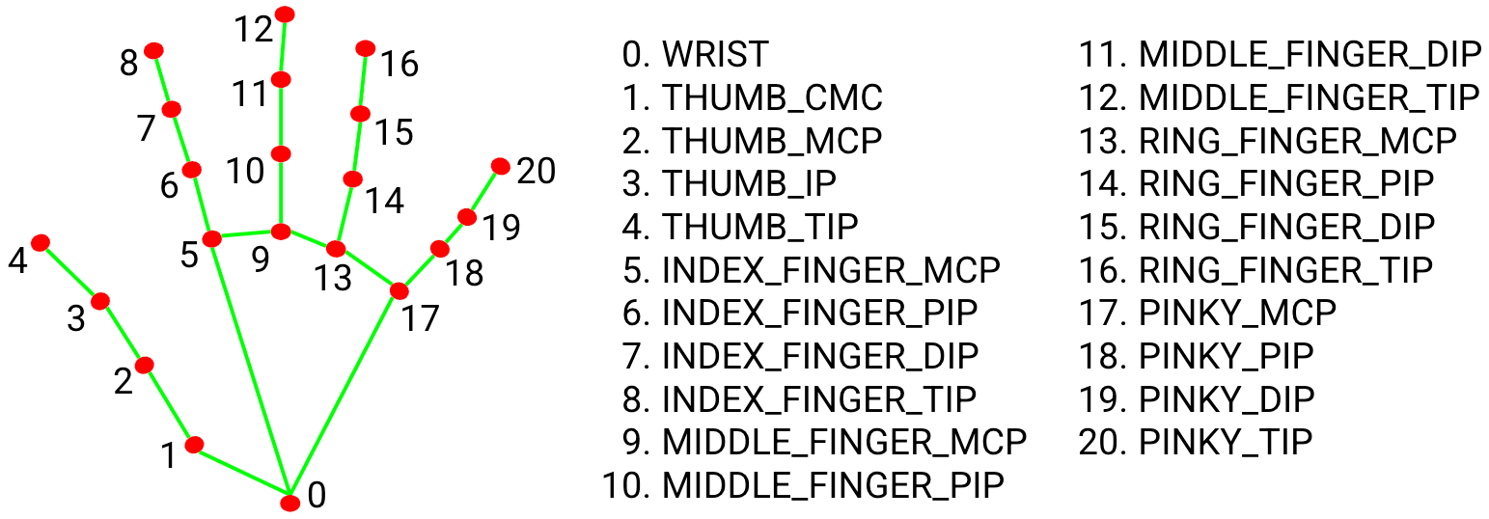
Hand Key Points

Slide 5
TensorFlow
What is tensorflow?
Initializing Tensorflow
It can be used for a variety of tasks, but it focuses on deep neural networks in particular.
Artificial neural networks are another name for neural networks. It's a branch of machine learning that's at the heart of deep learning algorithms.

Slide 6
OpenCV
Open Source Computer Vision Library
04
Originally developed by Intel
03
Can detect realtime frames from the system
02
It is a cross platform Library (Also Available for Ios and Android)
01

Slide 7
Prediction - Real time
This is where tensorflow’s deep learning component “keras” comes in.
The hand points detected through mediapipe is stored in an empty list as x and y coordinates.
Input 1
Input 2
Reading Frames from Webcam.
Predefined labels for the detected signs.

Slide 8
To summarize the working of real time model
01 | Initializing the computer vision algorithm
02 | Recognizing the hand points and reading the frames from webcam using Mediapipe
03 | Storing the hand points coordinates in a list
04 | Recognizing the hand gestures by using the training model
05 | Predicting the hand signs by tensorflow

